Slide 1






Understanding, Integrating, and Discussing Data with LLMs
Ioannis Dasoulas, Duo Yang, Xuemin Duan, Anastasia Dimou
ioannis.Dasoulas@kuleuven.be
Flanders Make Conference 2026

Slide 2
Data understanding is fundamental across industries…
Data understanding: Comprehending data’s meaning, qualities, structure
Crucial for:
Data cleaning
Data integration
Machine learning
Data Analysis / Knowledge discovery
Notes:
Data are everywhere in the modern industry, in every company and institute. However, raw data are often useless, if we don’t know how to process them.
So, understanding data in depth is one of the most fundamental steps that is often underestimated
Whether we are cleaning data, integrating multiple datasets, or building machine learning models, the quality of the results depends on how well we understand the structure and meaning of the data.

Slide 3
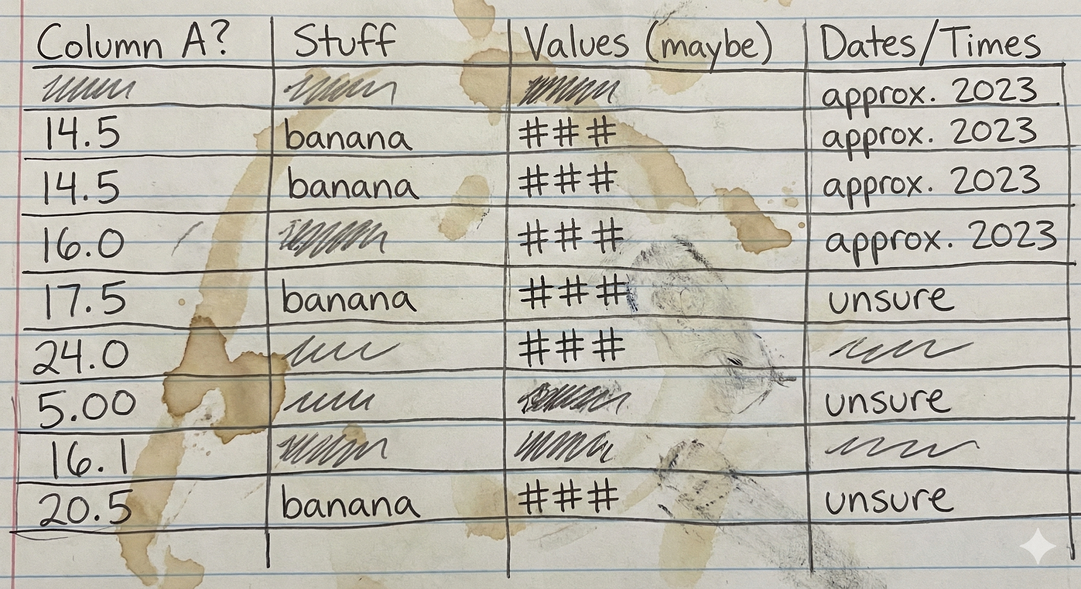
… but presents many challenges
Data understanding challenges:
Low quality of data (e.g. missing data or lack of structure)
Data ambiguity (meaning changes depending on context)
Level of understanding varies depending on the task
Notes:
However, there exist many challenges:
Real data are messy…

Slide 4
Need for accurate data understanding as scale
Our work focuses on data understanding systems using data retrieval techniques and LLMs
Application of data understanding in :
Data enrichment
Data integration
Data exploration
Notes:
Our work focuses on building systems that bridge this gap.

Slide 5
Understanding, Integrating, and Discussing Data with LLMs
Data Understanding Via semantic annotation
Data Enrichment via Annotation-guided Querying
Automated Data Integration to Knowledge Graphs Leveraging Semantic Annotations
Rules-guided Data Exploration with LLMs

Slide 6
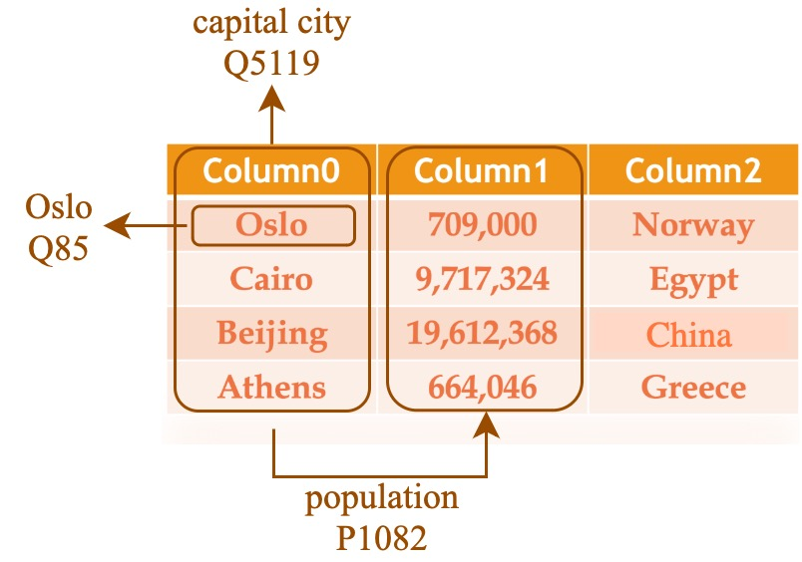
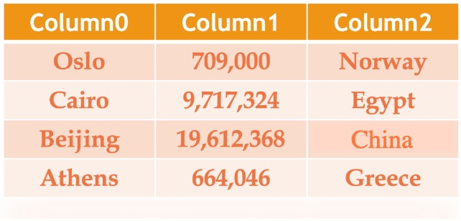
Data understanding through semantic annotation
Assignment of semantic tags to concepts, columns and relationships
Notes:
Our work focuses on understanding data by assigning semantic tags to them.

Slide 7
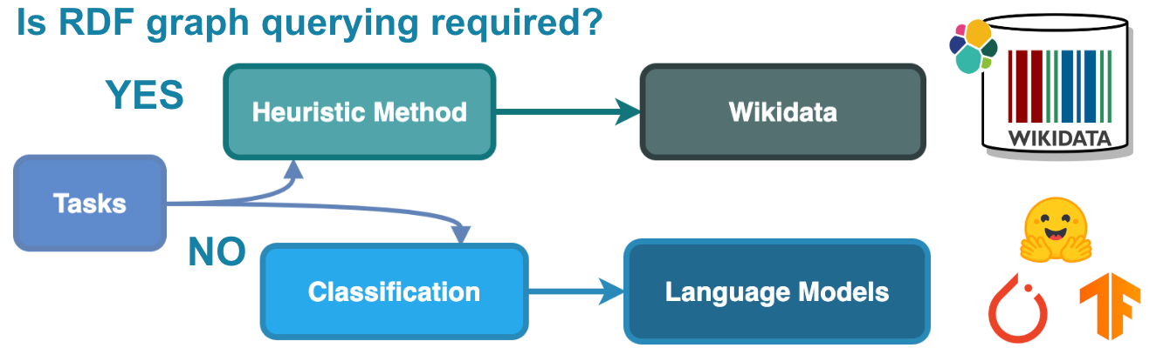
TorchicTab: A versatile semantic annotation system
Two complementary sub-systems:
Heuristic
Classification
TorchicTab
Notes:
Our work focuses on understanding data by assigning semantic tags to them.

Slide 8
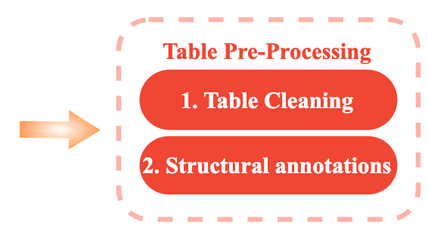
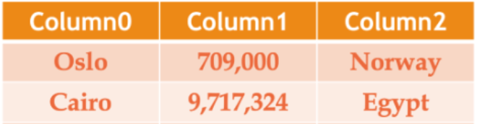
TorchicTab-Heuristic: Table pre-processing
L-column
NE-column
Table Cleaning & Structural Annotation
Noisy data removal
Incorrect encoding fix
Column type annotation

Slide 9
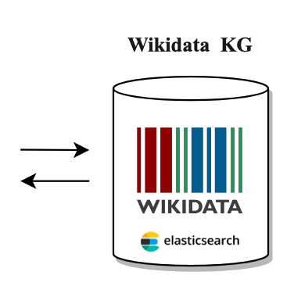
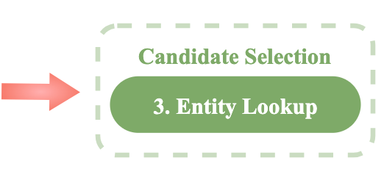
TorchicTab-Heuristic: Table pre-processing
L-column
NE-column
“Oslo” candidates
“Oslo” (Ship)
“Oslo” (Musical album)
“Oslo” (Capital of Norway)
“Osro” (Kansas community)
…

Slide 10
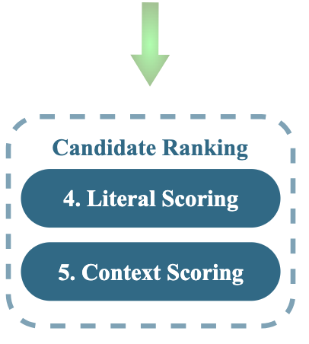
TorchicTab-Heuristic: Candidate ranking
L-column
NE-column

Slide 11
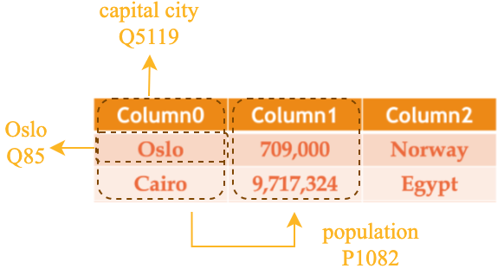
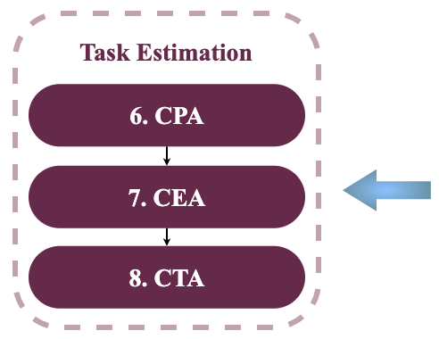

TorchicTab-Heuristic: Task Estimation
L-column
NE-column

Slide 12

TorchicTab-Heuristic: Python Package
Repository link: https://github.com/dtai-kg/TorchicTab-Heuristic
Install via pip: pip install torchic_tab_heuristic
Notes:
Our work focuses on understanding data by assigning semantic tags to them.

Slide 13
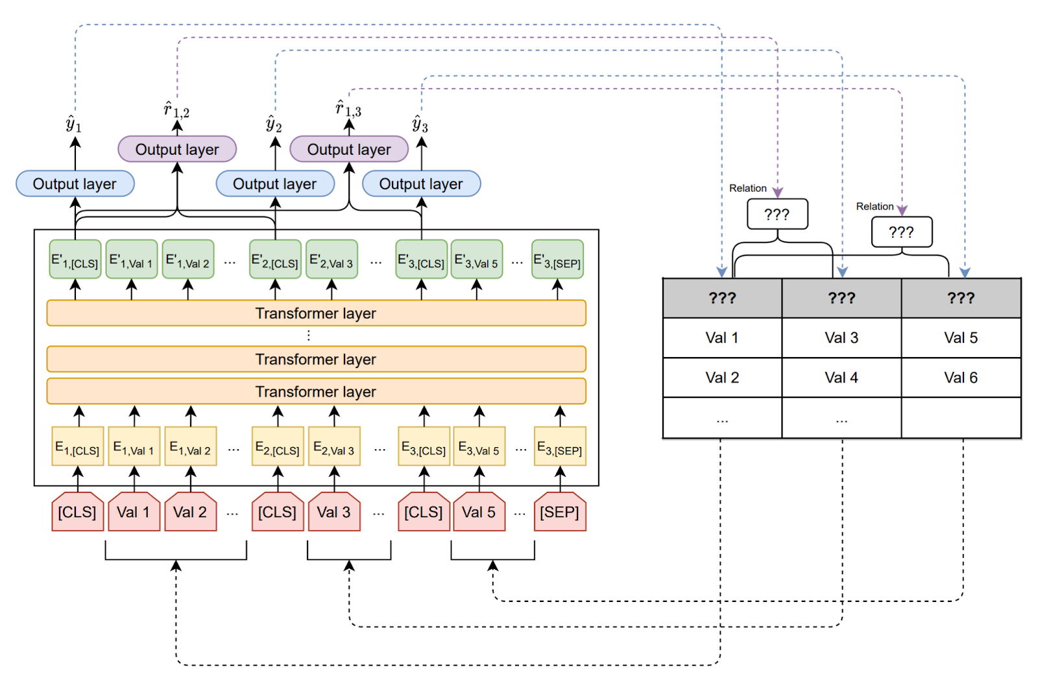
TorchicTab-Classification: DODUO Architecture
Semantic Annotations using (fine-tuned) LLMs
Notes:
Off-the-shelf LLMs OR fine-tuned
Large scale datasets

Slide 14
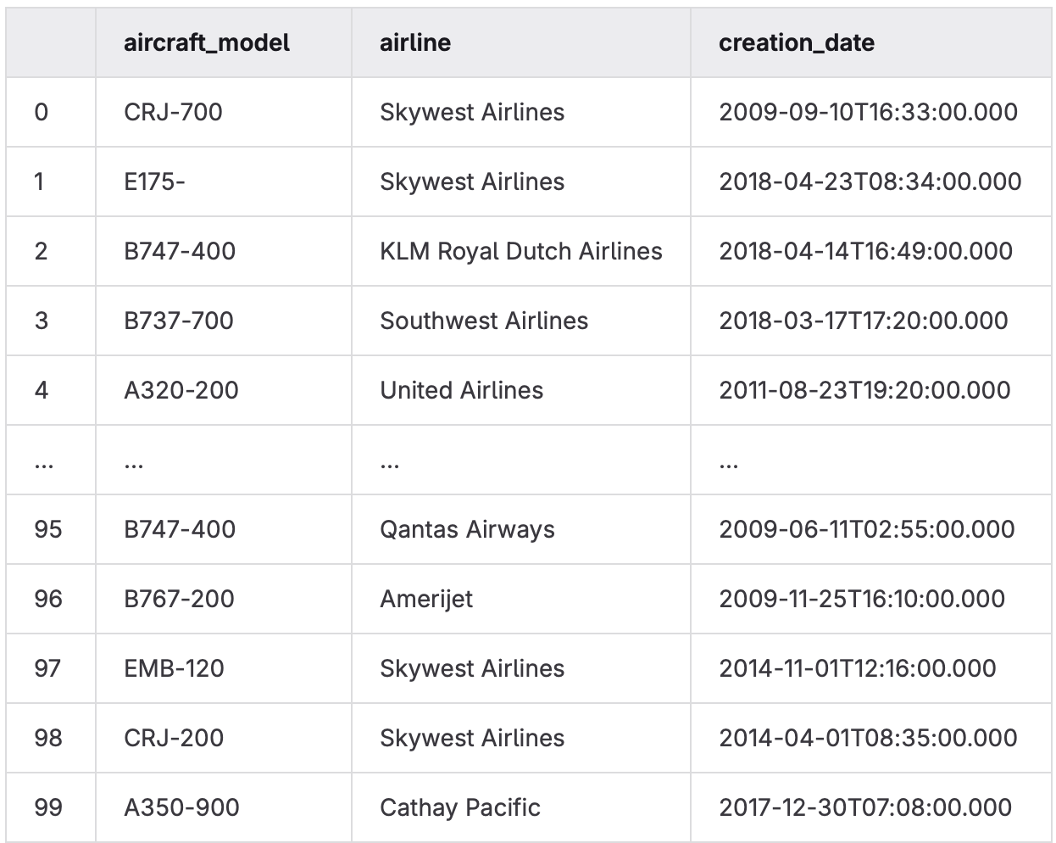

Demo: Data Understanding with TorchicTab
Understanding the data within an aircrafts dataset via semantic annotations
Tutorial link: https://github.com/dtai-kg/FlandersMake-Conference-Tutorial-2026
Notes:
Our work focuses on understanding data by assigning semantic tags to them.

Slide 15
Understanding, Integrating, and Discussing Data with LLMs
Data Understanding Via semantic annotation
Data Enrichment via Annotation-guided Querying
Automated Data Integration to Knowledge Graphs Leveraging Semantic Annotations
Rules-guided Data Exploration with LLMs

Slide 16
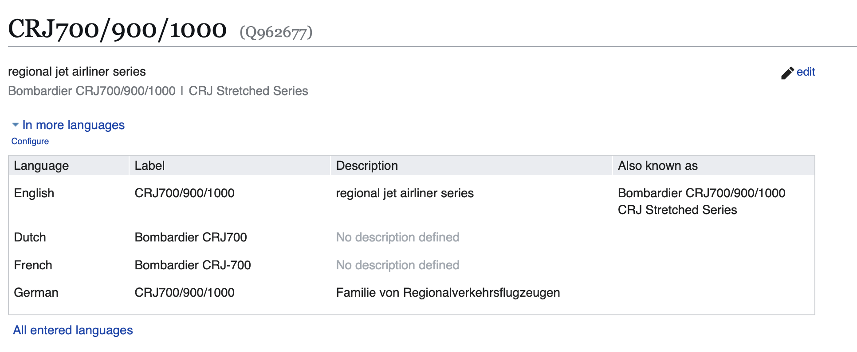
Data Enrichment Guided by Semantic Annotations
We can enrich our data leveraging the generated semantic annotations
Notes:
Our work focuses on understanding data by assigning semantic tags to them.

Slide 17
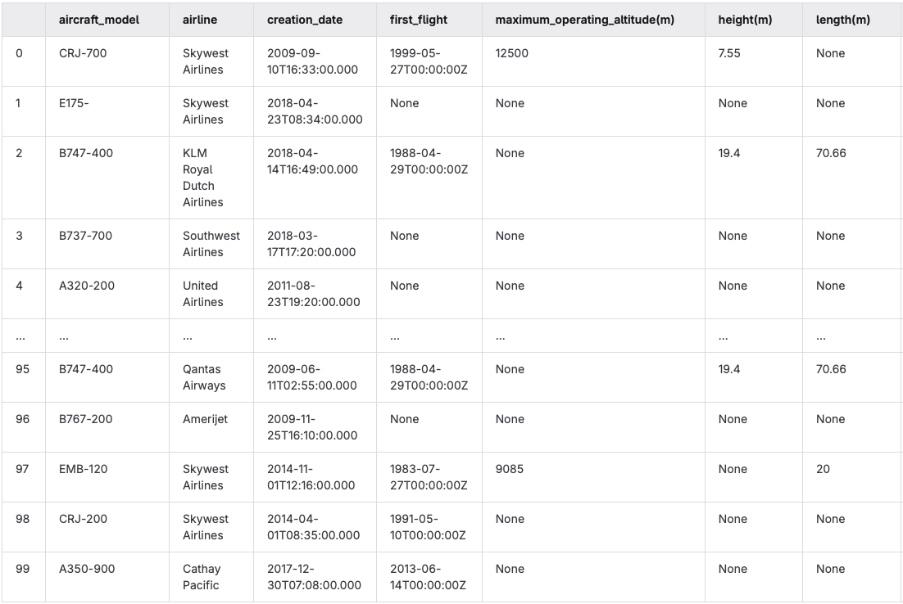
Demo: Data Enrichment Guided by Semantic Annotations
Tutorial link: https://github.com/dtai-kg/FlandersMake-Conference-Tutorial-2026
Notes:
Our work focuses on understanding data by assigning semantic tags to them.

Slide 18
Understanding, Integrating, and Discussing Data with LLMs
Data Understanding Via semantic annotation
Data Enrichment via Annotation-guided Querying
Automated Data Integration to Knowledge Graphs Leveraging Semantic Annotations
Rules-guided Data Exploration with LLMs

Slide 19
Why transform to knowledge graphs?
Knowledge graphs: Structured networks of interconnected entities and relationships
They offer:
Improved search and discovery of connections through complex relationships between data points
Enhanced reasoning and inference by linking heterogeneous data
Scalability and flexibility through easy integration of new information
Notes:
- Tables are often isolated. To reason between multiple data we can build knowledge graphs

Slide 20
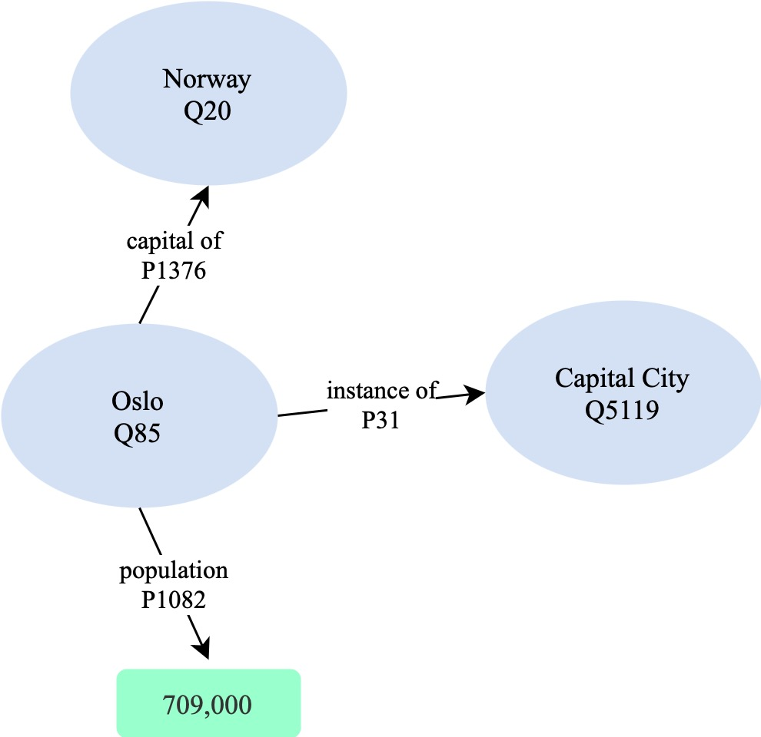
Automated Data Integration to Knowledge Graphs Leveraging Semantic Annotations
Semantic annotations can be used to automatically transform and integrate data
Notes:
- Tables are often isolated. To reason between multiple data we can build knowledge graphs

Slide 21
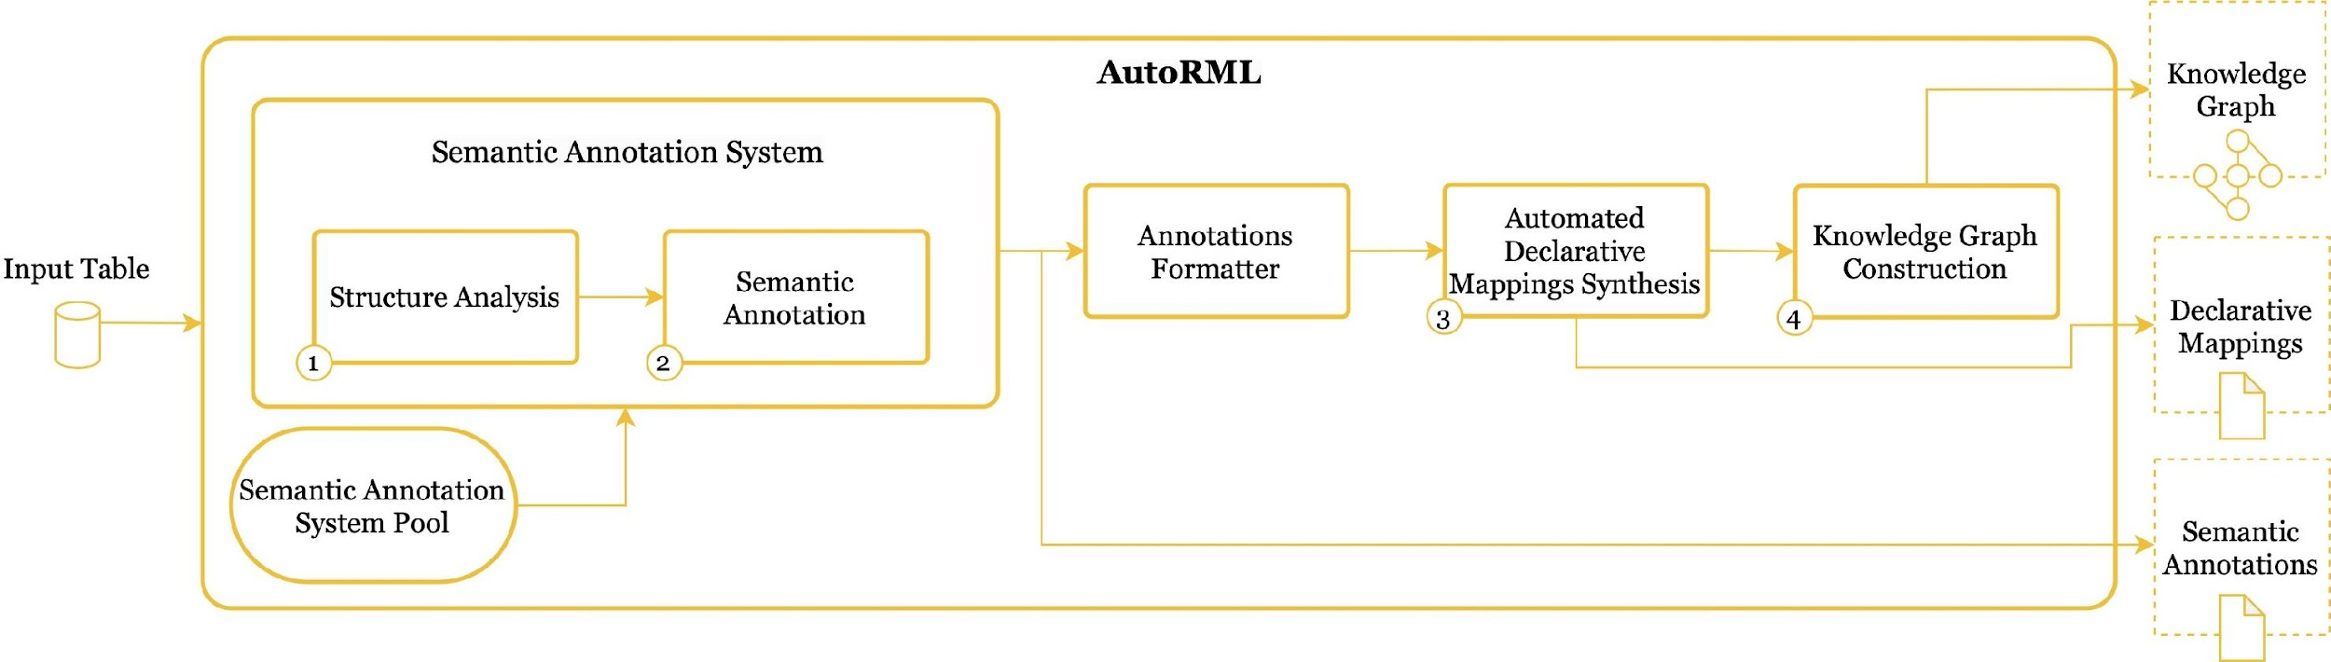
AutoRML: Automated Knowledge Graph Construction using Semantic Annotations
Semantic annotations are used to automatically generate data transformation mappings

Slide 22
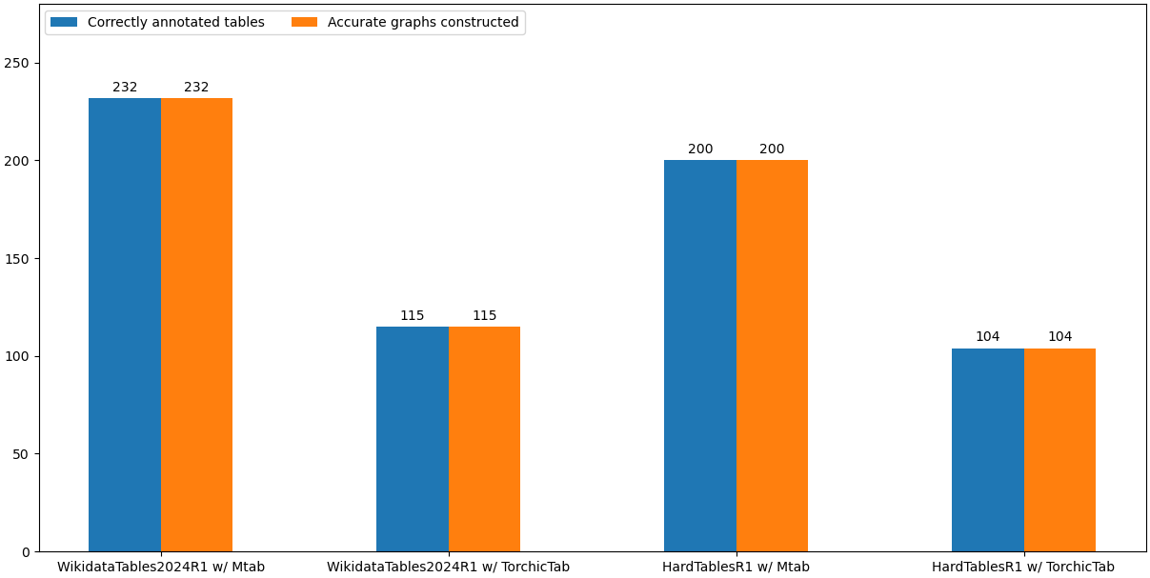
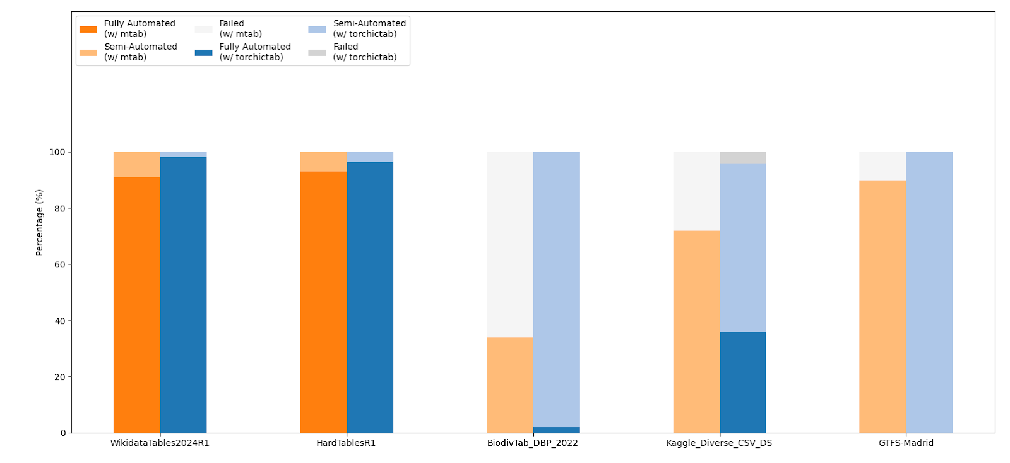
AutoRML: Automated Knowledge Graph Construction using Semantic Annotations
Knowledge graph construction can be automated given high-quality semantic annotations

Slide 23

Autorml: Python Package
Repository link: https://github.com/dtai-kg/AutoRML
Install via pip: pip install autorml
Notes:
Our work focuses on understanding data by assigning semantic tags to them.

Slide 24
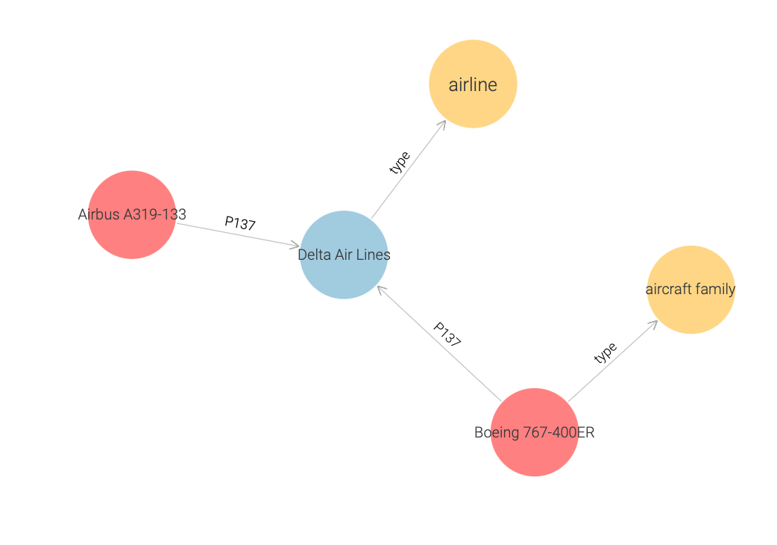
Demo: Automated Knowledge Graph Construction with AutoRML
Tutorial link: https://github.com/dtai-kg/FlandersMake-Conference-Tutorial-2026
Notes:
Our work focuses on understanding data by assigning semantic tags to them.

Slide 25
Understanding, Integrating, and Discussing Data with LLMs
Data Understanding Via semantic annotation
Data Enrichment via Annotation-guided Querying
Automated Data Integration to Knowledge Graphs Leveraging Semantic Annotations
Rules-guided Data Exploration with LLMs

Slide 26
Need for User-Friendly Data Exploration
Data exploration is necessary but often challenging:
Non-technical users find it difficult to query data
Query languages vary, depending on data model
Hence, there is a need for natural language data querying to allow user-friendly
data exploration.
LLMs provide new avenues to do that effectively, but might often:
Hallucinate
Generate inaccurate / incomplete results
Notes:
- Tables are often isolated. To reason between multiple data we can build knowledge graphs

Slide 27










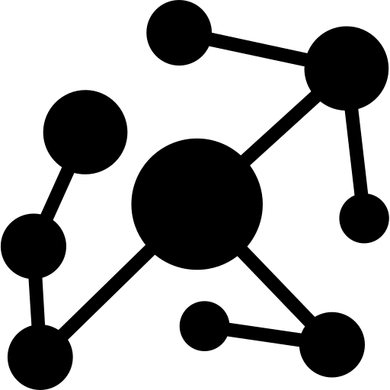
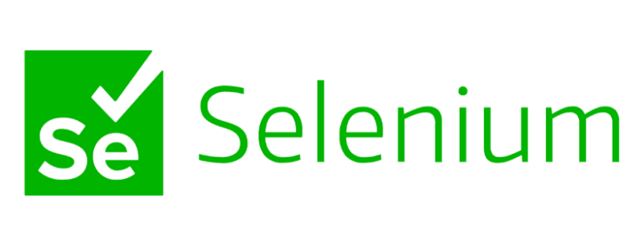


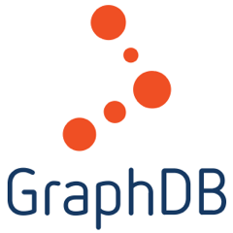
Natural Language Annotation-Guided Data Exploration with LLMs
searching websites…
searching knowledge graph…
Automating Web UI
Web Interface
Endpoint
Notes:
- Tables are often isolated. To reason between multiple data we can build knowledge graphs

Slide 28
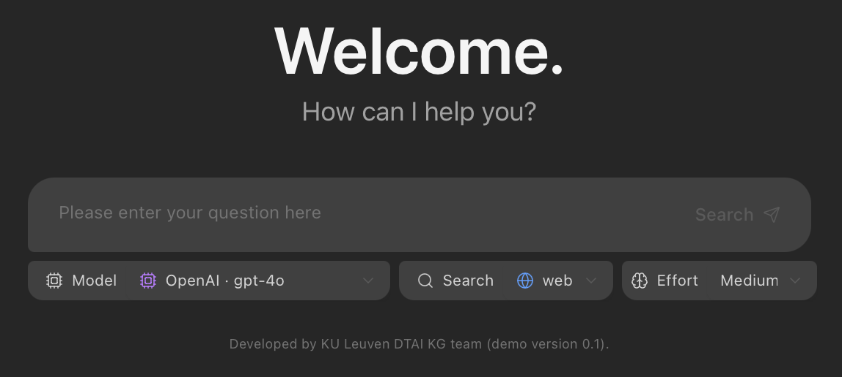
Demo: Natural Language Data Exploration with LLMs
Notes:
Our work focuses on understanding data by assigning semantic tags to them.

Slide 29
The importance of data understanding across applications
We showed how data understanding:
a. Can be achieved with data retrieval or LLM techniques
Notes:
Our work focuses on understanding data by assigning semantic tags to them.

Slide 30
The importance of data understanding across applications
We showed how data understanding:
b. Enables data enrichment
Notes:
Our work focuses on understanding data by assigning semantic tags to them.

Slide 31
The importance of data understanding across applications
We showed how data understanding:
c. Enables automated data transformation
Notes:
Our work focuses on understanding data by assigning semantic tags to them.

Slide 32
The importance of data understanding across applications
We showed how data understanding:
d. Enables controlled data exploration with LLMs
Notes:
Our work focuses on understanding data by assigning semantic tags to them.

Slide 33
Understanding, Integrating, and Discussing Data with LLMs
Ioannis Dasoulas, Duo Yang, Xuemin Duan, Anastasia Dimou
ioannis.Dasoulas@kuleuven.be
Flanders Make Conference 2026

Slide 34

Demo and slides:
IOANNIS DASOULAS, DUO YANG, XUEMIN DUAN, ANASTASIA DIMOU
{FIRST_NAME.LAST_NAME}@KULEUVEN.BE
FLANDERS MAKE CONFERENCE 2026

